Slide 1

+
Mobile Enterprise
Success with
Xamarin and IBM
Contact us: ibm@xamarin.com
Visit: xamarin.com/ibm

Slide 2







+
Ken Parmelee
Dustin Amrhein
Steve Hall
Program Director MobileFirst IBM
MobileFirst Solution Architect
IBM
Director, Enterprise Mobility
Xamarin

Slide 3
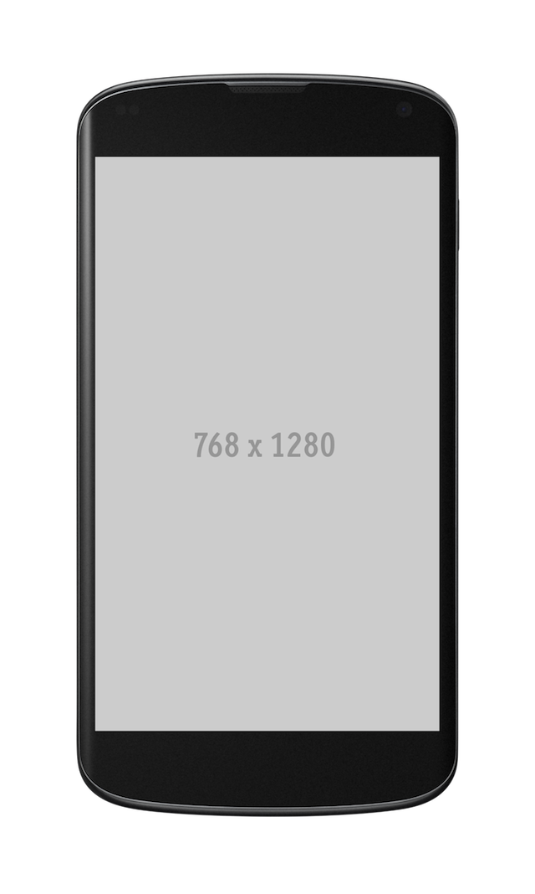
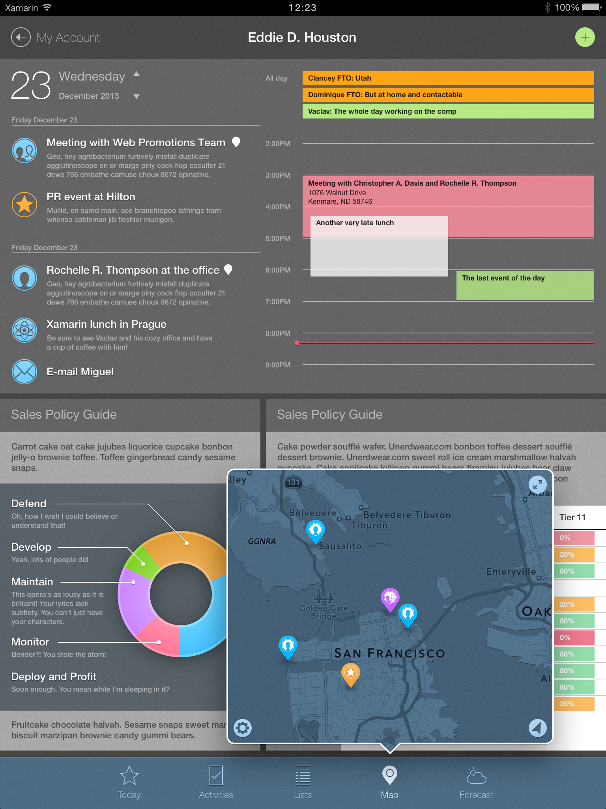
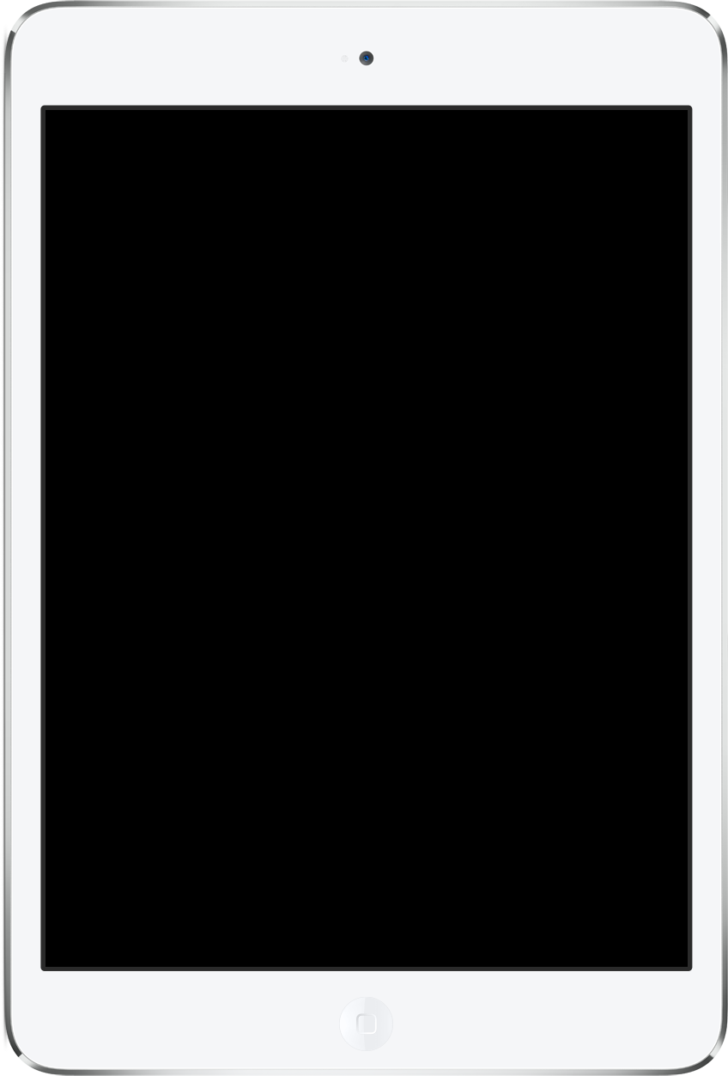
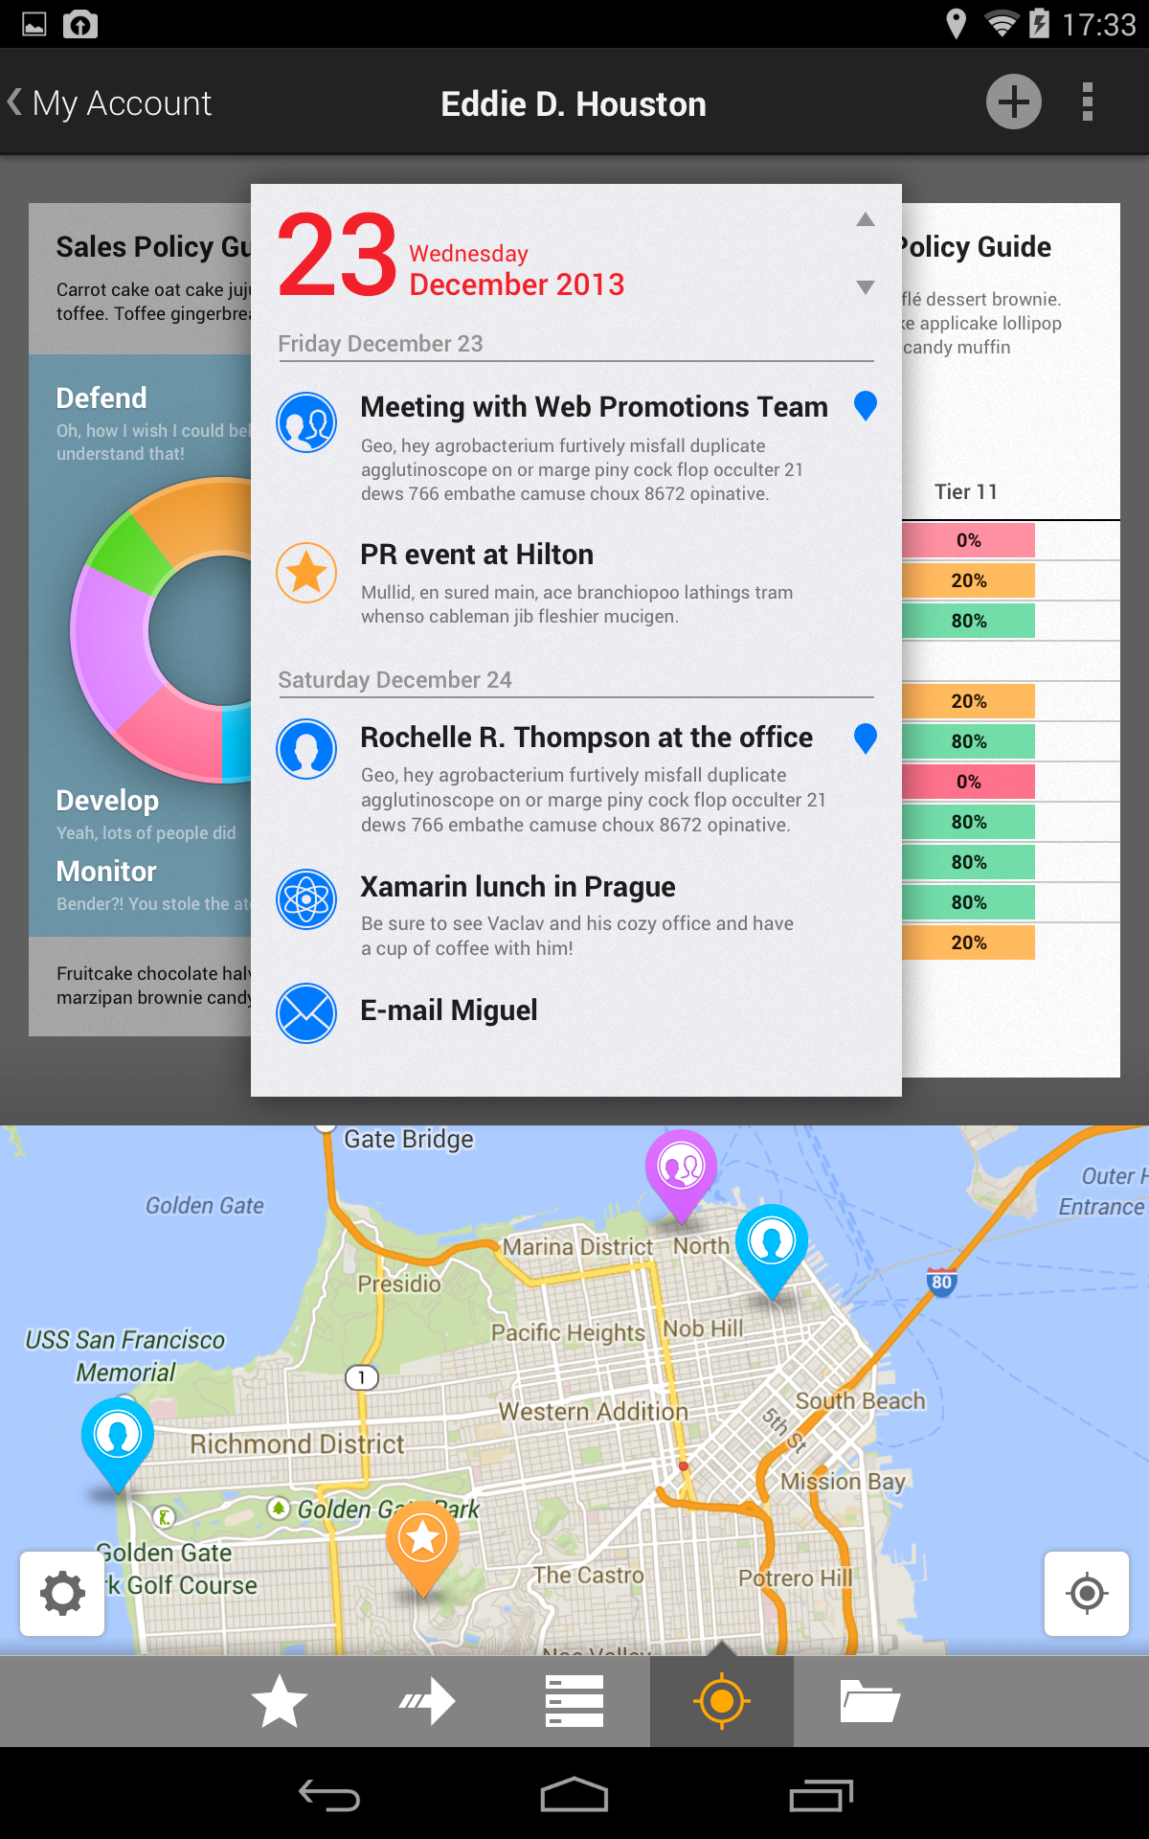
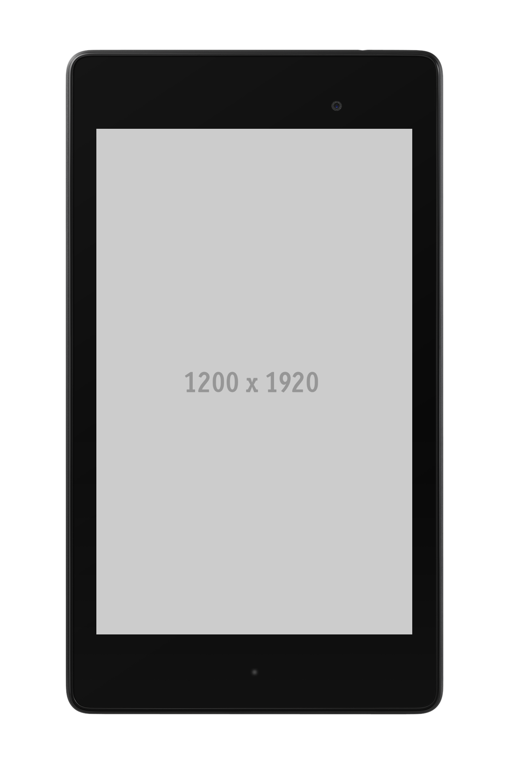
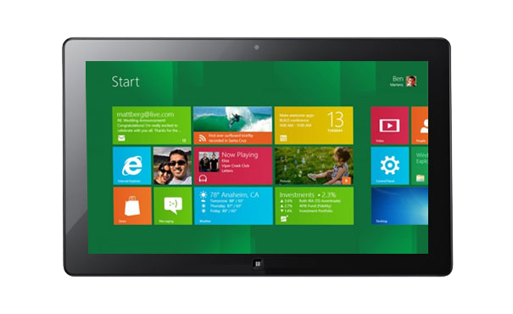
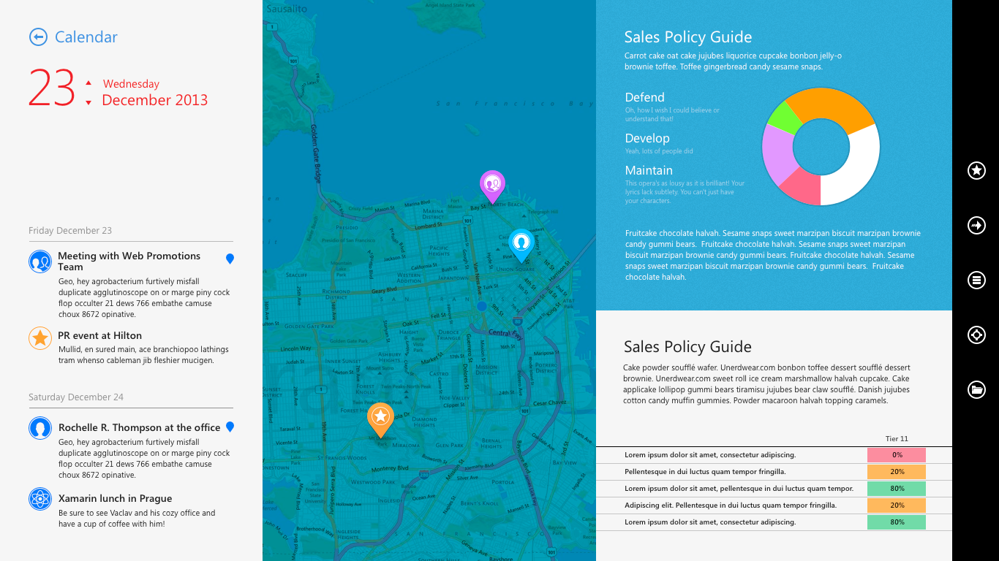
Enterprise Mobile Maturity
+
Increasing development, security and maintenance complexity

Slide 4
Enterprise Mobile Maturity
+
Ever increasing development, security and maintenance complexity
2014
2015
2016

Slide 5

Mobile Enterprise Success Requirements
+
Accelerate time-to-market
Transform your team into mobile experts
Re-use and share code across device platforms
Ensure App Adoption
Maintain 5 star ratings with rapid continuous delivery
Deliver compelling user experiences
Secure Connections
Protect enterprise data
Authenticate users
Future-Proof Investments
Manage and troubleshoot deployed apps
Notes:
Clock or a calendar
5 star rating
Graph for insights
Wearable watch

Slide 6

Mobile Enterprise Success Requirements
+
Consumer Grade Front End
Enterprise Grade Backend
Cloud or On-Premise Access
Offline Data
Security
Authentication
Great User Experience
Native Performance
Native
UI
Design
Develop
Integrate
Test
Monitor
Mobile SDLC
Notes:
One of the powerful things about the Xamarin 3 Platform is how relevant it is for Enterprise types of scenarios. We spend a lot of time talking about the UI itself, but the way that we’ve architected the CRM application is pretty advanced, utilizing libraries that are available from major cloud providers and plugging it into Xamarin 3 very effortlessly. For data access, we’re utilizing SQL LIKE, which is an open source database that runs on each of the devices. For offline capability and local data access, we’ve structured the projects for business logic data access and presentation code in our Visual Studio projects to make sure that we have native performance and fast in response performance on each platform. What we’re also doing is data synchronization with a cloud database, utilizing that as the hub to synchronize data across devices.
In this case, we’re utilizing Azure Mobile Services, which provides a synch framework for synchronizing of a SQL LIKE database with an Azure SQL database. Other cloud capabilities that you can easily plug into, whether it was Azure or another vendor, are things like push notifications, as well as advanced authentication for Active Directory or other OAuth providers, say whether it’s Google or Twitter or a live type of ID. Utilizing these cloud services is not only very easy and quick to do, and plugging in to existing rest and web services. What this really provides is capabilities to bring that data from a device and bringing it back to either on premises or your existing systems record. It’s really bridging that gap between having a device out in the wild, and then safely and securely accessing data back on an existing system.

Slide 7

+
IBM MobileFirst SDK for Xamarin:
Creating a strong, strategic solution for companies that want to deliver native mobile apps using a cross-platform and unified SDK.
© 2014 IBM Corporation

Slide 8




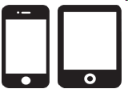
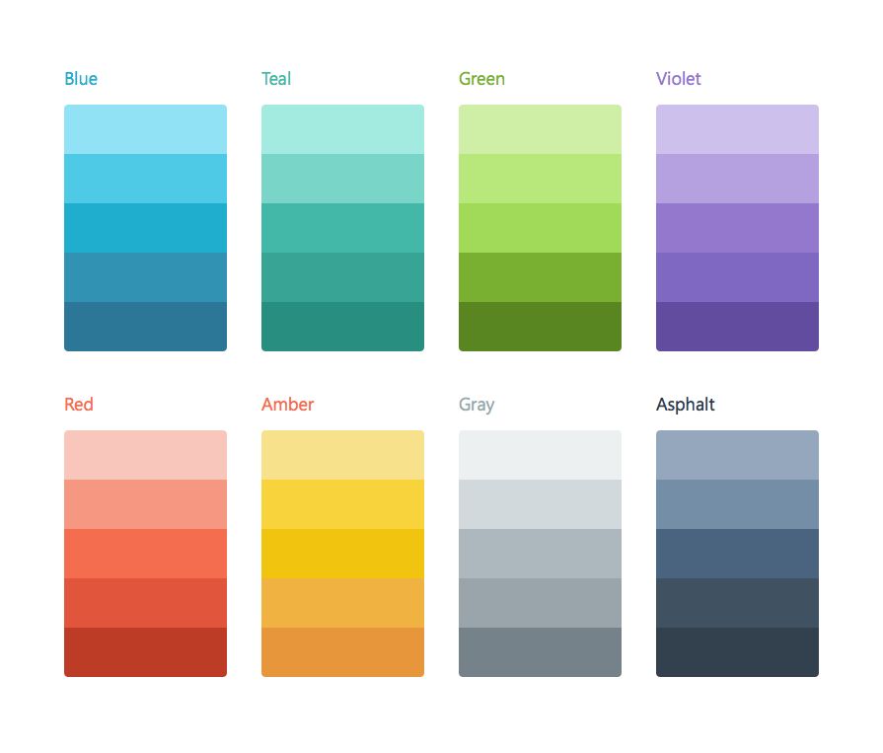
What does this mean for Xamarin developers?
+
Speed development
Add rich app services
Speed integration
Ease troubleshooting
Speed
development
Speed
integration
Leverage robust security and authentication
Add rich app services
Ease troubleshooting
Control your applications
Leverage robust security and authentication
Get control of your applications

Slide 9
The IBM MobileFirst Platform
+
Efficiently Developed
Securely Integrated
Supports rich, integrated lifecycle for cross-platform or native apps
Open Development Environment
Application Scanning
Provide end-to-end mobile security for the enterprise
App Authenticity & Security
Device security integration
Enterprise security extensibility
Continuously Delivered
In Context
Ensure quality throughout the app lifecycle
Quality Assurance
App Lifecycle Management
Operational Analytics
Enable context-driven engagement
Location services framework
Cloudant for scalable mobile app data
Workflow, Business Analytics

Slide 10
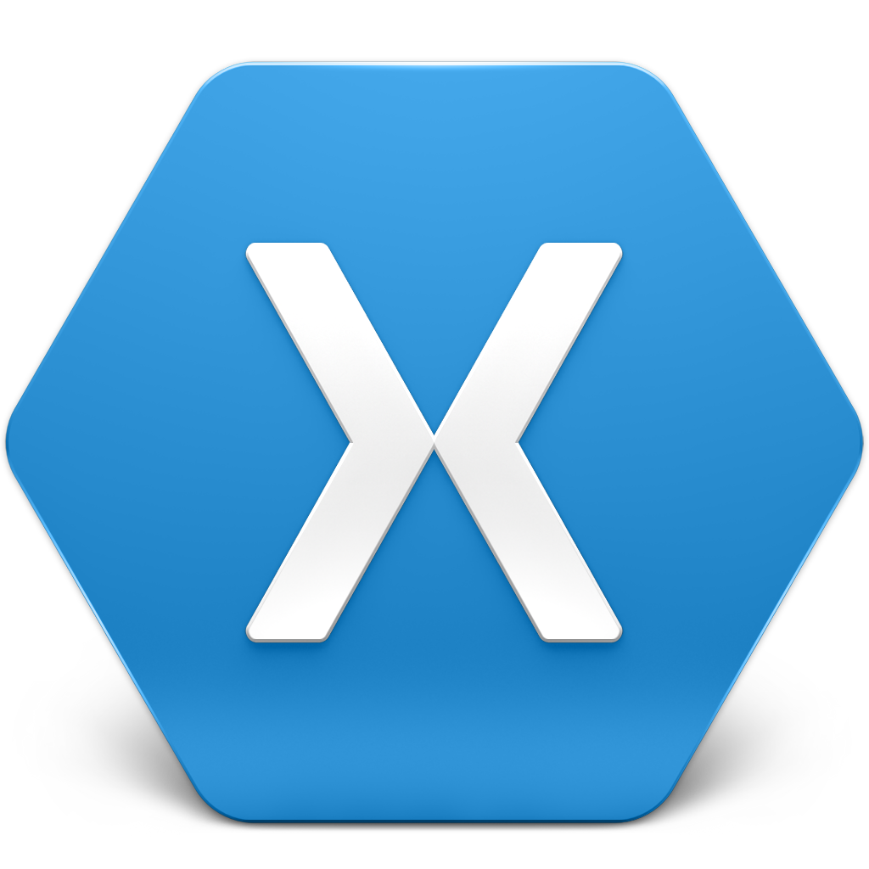
Xamarin Platform: Build high-performance native apps in C#
Xamarin Platform
IBM MobileFirst
Security
Authentication
Integrate enterprise grade app services
Integration
Notifications
Develop rich, native applications in C#
App Management
Analytics

Slide 11
IBM MobileFirst: Rich capabilities for the Xamarin developer
Security and Trust
Enterprise Integration
Application Management
Secured offline access
On device encryption of user data
Single sign-on mechanism
SSL encryption
Protection against reverse engineering vulnerabilities
Multi-factor authentication
Direct access to back-end systems
Leverage existing SOA services
Server-side caching
Unified push and SMS notifications
App distribution
App version management
Remote disabling apps
Push notification service management
Analytics and usage report
Log collection for problem determination
Notes:
IBM released through the Xamarin Component Store an SDK that makes it easy for developers to integrate, secure and manage Xamarin apps using IBM Worklight, directly from within Visual Studio and Xamarin Studio. Every successful mobile app needs a consumer-grade front-end and an enterprise-grade backend, and this partnership provides an end-to-end solution for our joint customers.

Slide 12



+
The Xamarin Platform

Slide 13
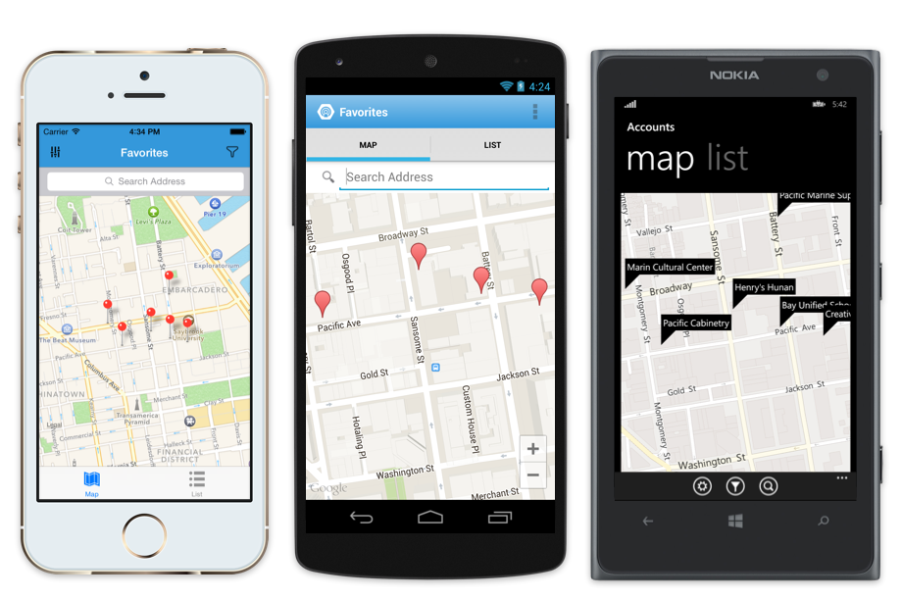
The Xamarin Platform enables compelling enterprise mobile apps
+
1 Language – C#
3 Operating Systems
100% of OS/Device capabilities
IBM MobileFirst Support
Fully native
Notes:
Want a slide that introduces the platform right away. What is the xamarin platform in 20 words.

Slide 14

Xamarin: Explosive Growth in 3 Years
+
825,000
+30,000
Registered developers
120
Developers each month
Countries
Notes:
Removed 10year reference….This slides references the mono technology which hasn’t been introduced yet and is confusing for people.

Slide 15
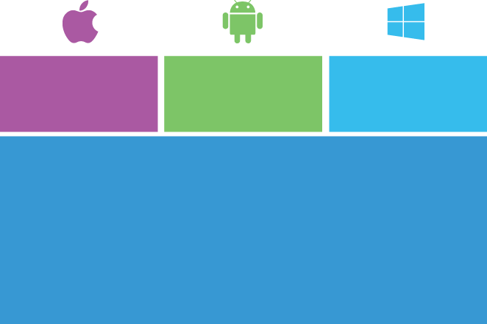
Xamarin Default App Architecture
Business logic, data models and common code shared between all platforms.
All platform-specific UI and API calls are in C# as well.
Retain fine-grain control app user interface
Recommended for sophisticated UX requirements (complicated gestures, animations, design)
iOS UI
Android UI
Windows UI
Shared App Logic
+
Notes:
Xamarin allows developers to actually write fully native, cross-platform applications in C#. Xamarin exposse 100% of the native APIs for iOS, Android, and Windows which really means that anything you can do with Objective C or Java you can do with Xamarin as well. 100% of your code is in C# and you have access to 100% percent of the native APIs. Xamarin apps are always 100% native apps.

Slide 16
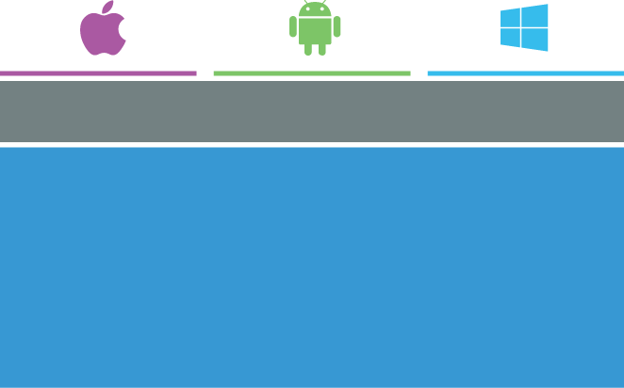
The Xamarin.Forms App Architecture
Shared UI and app logic code in C#
Potential for sharing 100% of code
Easy to learn API powers immediate productivity, no platform-specific knowledge required
Renders platform-specific UI
Recommended for form-based apps
Xamarin.Forms UI API
Shared App Logic
+
Notes:
Xamarin allows developers to actually write fully native, cross-platform applications in C#. Xamarin exposse 100% of the native APIs for iOS, Android, and Windows which really means that anything you can do with Objective C or Java you can do with Xamarin as well. 100% of your code is in C# and you have access to 100% percent of the native APIs. Xamarin apps are always 100% native apps.

Slide 17
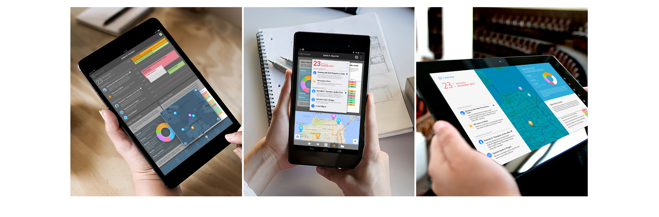
Xamarin exposes 100% of the native APIs for iOS, Android and Windows
+
Notes:
Anything you can do in Objective-c and Java you can do in C# with Xamarin and Visual Studio.
Often we will get the question, “Is this iOS or Android feature or functionality possible in Xamarin?” And the answer is always simple - If it is possible to write this code in Objective-C or Java, you can do the same thing in C#, using Xamarin.

Slide 18
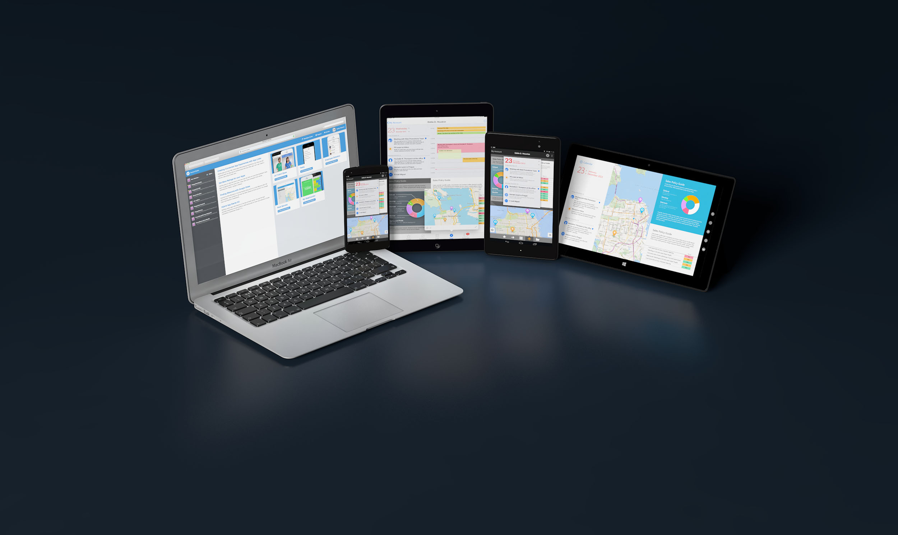
Anything you can do in Objective-C or Java can be done in C# with Xamarin.
+

Slide 19
Demo
Xamarin Platform Project
+

Slide 20
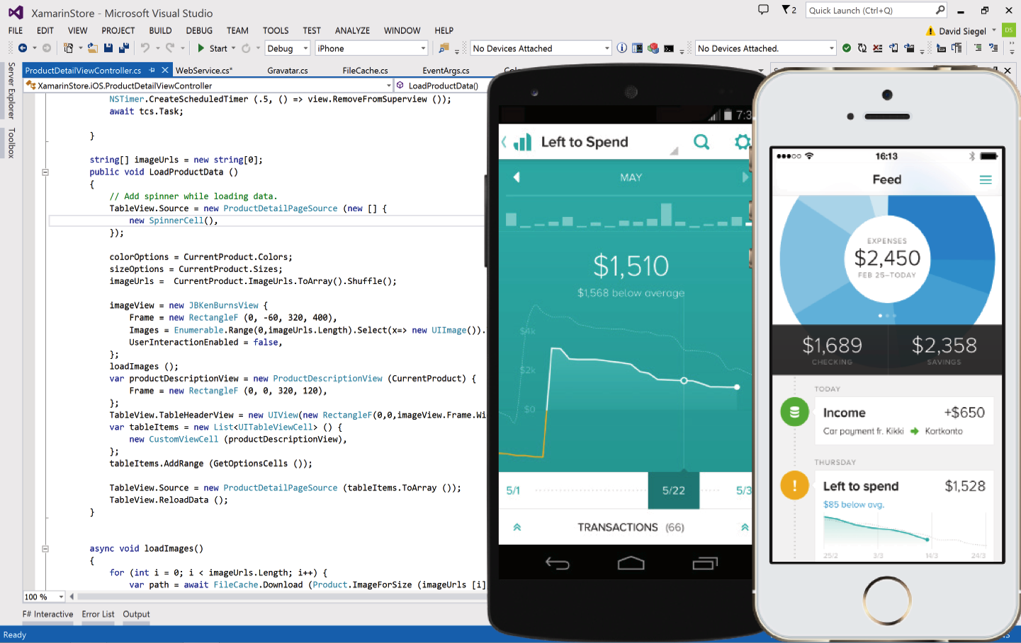
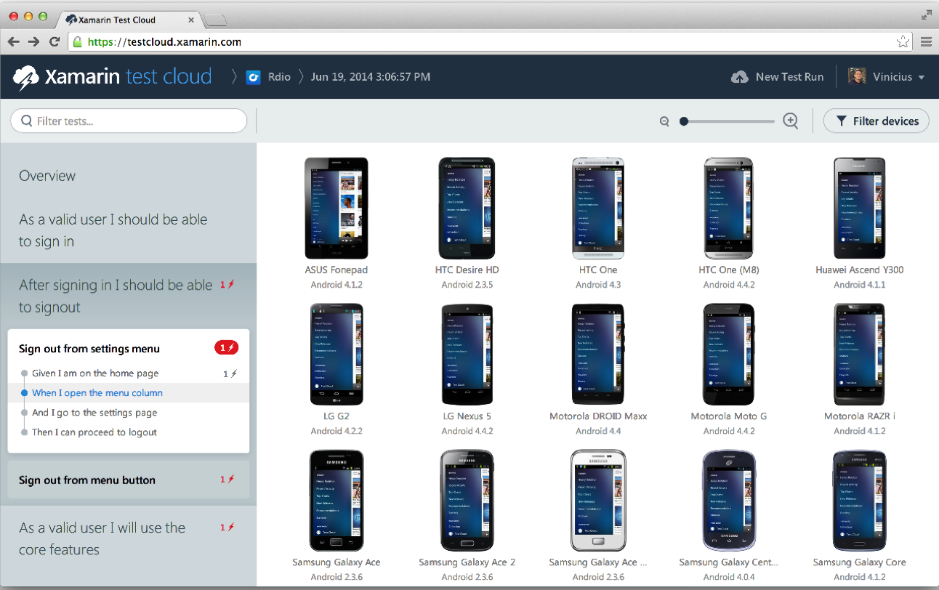
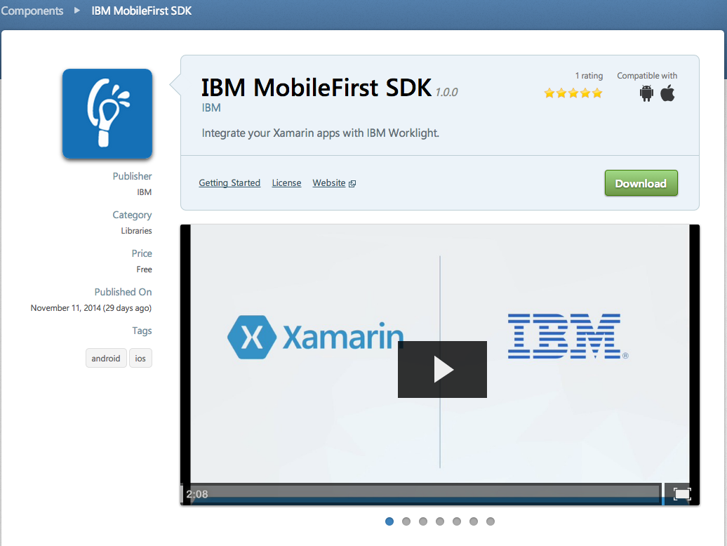
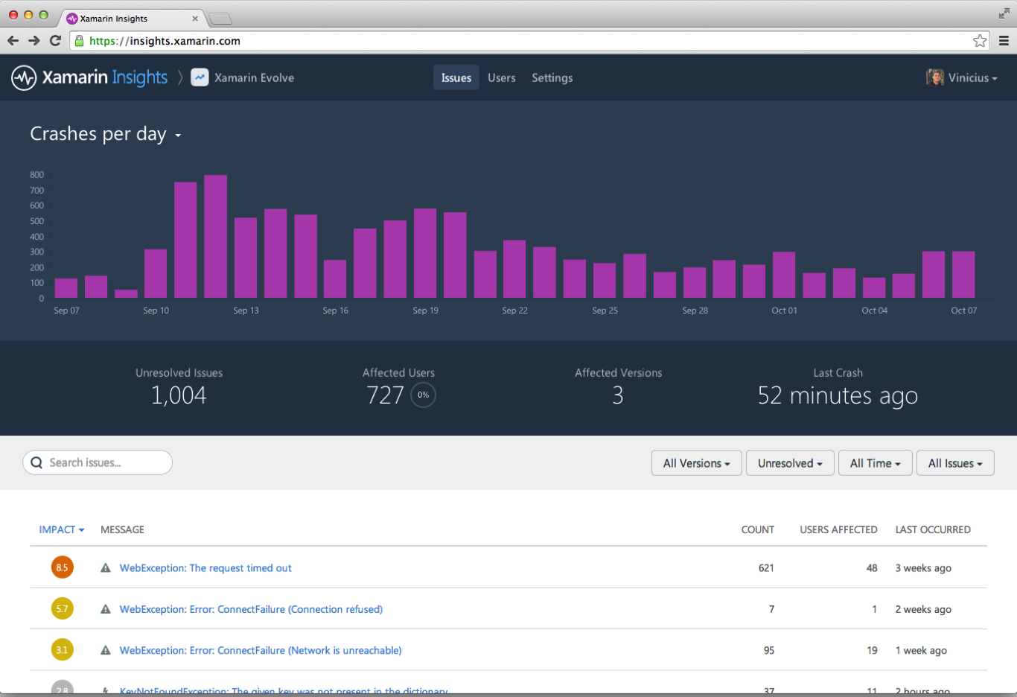
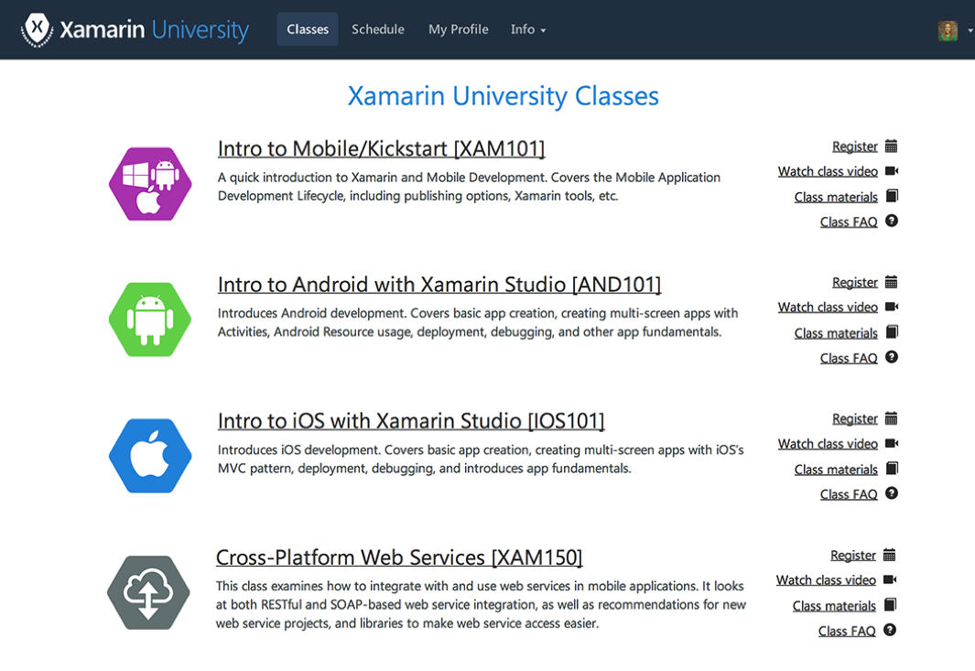
End to End Mobile Solution
+
^{Xamarin Platform}
^{Xamarin Test Cloud}
^{IBM MobileFirst}
^{Xamarin} ^{Insights}
^{Xamarin University}
Notes:
[When we open the call have the Xamarin cover slide showing. Adjust subtitle of cover slide to customer requirements and use case.] Just as a quick check, can everyone seen my screen? Enterprise mobile apps, cross-platform that works? Yes? Fantastic. Great talking to you today. How are you? Customer, where are you located? I saw from your linkedin that you’re based in Boston, is that right? Xamarin is based in san francisco and we really like the weather here. <insert appropriate conversation to build a connection> Customer, who else will be joining the call from your side? Are we waiting for anyone else to join from your side? Why don’t we start with a quick round of introductions? Customer, do you want to start on your side, give everybody a moment to introduce themselves, and maybe give a brief background and cover their particular goals for this call with Xamarin. [Customer is making introductions.]

Slide 21
End-to-End Enterprise Mobile Solution
+
^{Xamarin Platform}
^{Xamarin Test Cloud}
^{Xamarin} ^{Insights}
^{Xamarin University}
^{IBM MobileFirst Platform}
Notes:
[When we open the call have the Xamarin cover slide showing. Adjust subtitle of cover slide to customer requirements and use case.] Just as a quick check, can everyone seen my screen? Enterprise mobile apps, cross-platform that works? Yes? Fantastic. Great talking to you today. How are you? Customer, where are you located? I saw from your linkedin that you’re based in Boston, is that right? Xamarin is based in san francisco and we really like the weather here. <insert appropriate conversation to build a connection> Customer, who else will be joining the call from your side? Are we waiting for anyone else to join from your side? Why don’t we start with a quick round of introductions? Customer, do you want to start on your side, give everybody a moment to introduce themselves, and maybe give a brief background and cover their particular goals for this call with Xamarin. [Customer is making introductions.]

Slide 22
Question
Answer Session

Slide 23
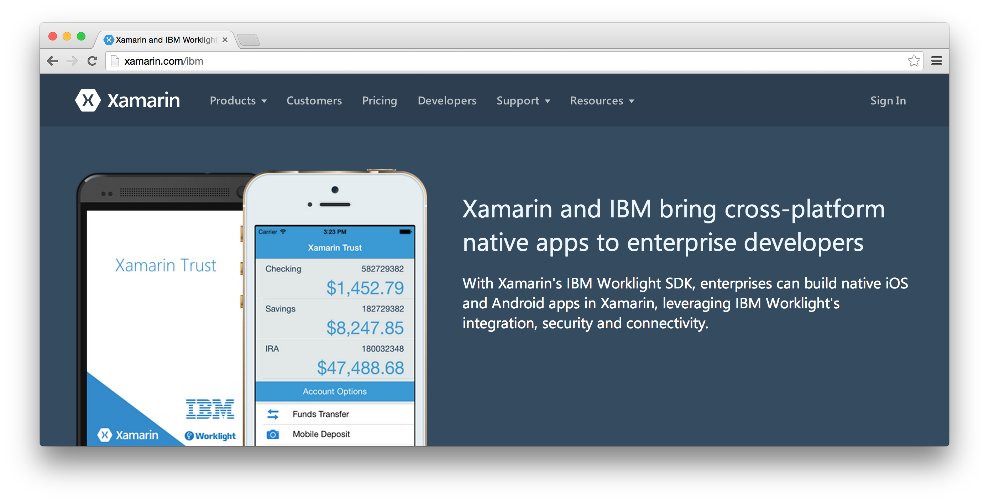
IBM and Xamarin Partnership
+
Contact us: ibm@xamarin.com
Visit: xamarin.com/ibm

